Slide 1


“Information Security”
Lecture # 2
Dr. Engr. M Malook Rind
Ph.D (I.T), ME (CSN), MBA (MIS), BE (CS)
CCNA, CCNP, Juniper Certified.
Professor (Computer Science)

Slide 2
Contents
The CIA Triad
Attacks
Hacking
Cyber Kill Chain Methodology
Dr. M Malook Rind Information Security Lecture 2

Slide 3
The CIA Triad
Dr. M Malook Rind Information Security Lecture 2

Slide 4

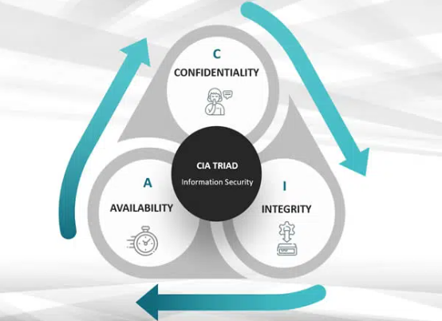
Confidentiality, Integrity, and Availability – The CIA Triad
The CIA triad is widely accepted as a model in information security. This basis for information security (IS) was developed in the 1980s.
Dr. M Malook Rind Information Security Lecture 2

Slide 5
Confidentiality, Integrity, and Availability – The CIA Triad
The CIA triad has three components: Confidentiality, Integrity, and Availability.
Confidentiality
Confidentiality involves the efforts to make sure data is kept secret or private. This often means that only authorized users and processes should be able to access or modify data.
Integrity
Integrity involves making sure the data is trustworthy and free from tampering. It should be maintained in a correct state, kept so that it may not be tampered with, and should be correct, authentic, and reliable.
Availability
Just as it is important that unauthorized users are kept out of an organization’s data, data should be available to authorized users whenever they require it. This means keeping systems, networks, and devices up and running.
Dr. M Malook Rind Information Security Lecture 2

Slide 6
Importance of CIA Triad
CIA triad is the cornerstone for the Information security professionals.
The CIA triad constitutes the core basis for the development of security systems and policies for institutions. As such, the CIA triad plays a critical part in maintaining your data safe and protected against growing cyber threats.
The CIA triad provides organizations with a clear and comprehensive checklist to evaluate their incident response plan in the event of a cyber breach.
The contrary of confidentiality, integrity, and availability is disclosure, alteration, and destruction.
Disclosure: When an authorized group gains access to your information.
Alteration: When data is altered or modified.
Destruction: When data, systems, or applications are destroyed or rendered inapproachable.
Dr. M Malook Rind Information Security Lecture 2

Slide 7
Importance of CIA Triad
CIA Triad Example
Consider an ATM that allows users to access bank balances and other information. An ATM incorporates measures to cover the principles of the triad:
The two-factor authentication (debit card with the PIN code) provides confidentiality before authorizing access to sensitive data.
The ATM and bank software ensure data integrity by maintaining all transfer and withdrawal records made via the ATM in the user’s bank accounting.
The ATM provides availability as it is for public use and is accessible at all times.
Dr. M Malook Rind Information Security Lecture 2

Slide 8
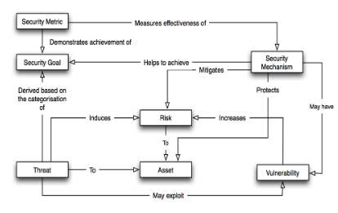
What are some means of achieving the CIA security goals
Authorization, authentication and the use of cryptography are some techniques to achieve the CIA security goals. These have been sometimes called Security Mechanisms.
These mechanisms are designed to protect assets and mitigate risks. However, they may have vulnerabilities that threats will attempt to exploit.
Dr. M Malook Rind Information Security Lecture 2

Slide 9
Attacks
Dr. M Malook Rind Information Security Lecture 2

Slide 10
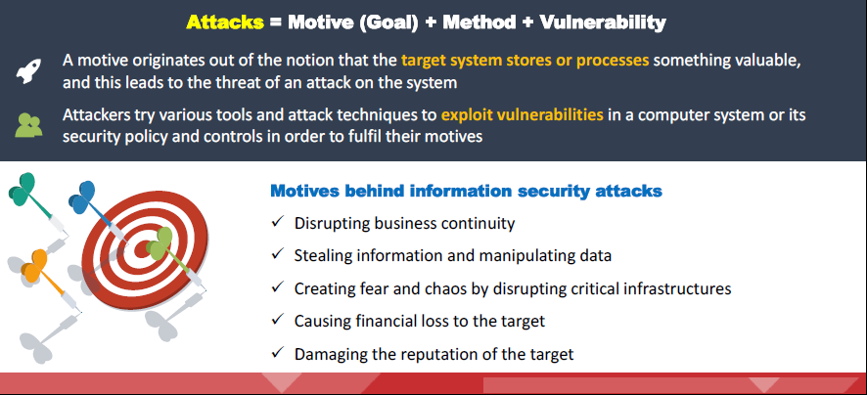
Motives, Goals, and Objectives of Information Security Attacks
Attackers generally have motives (goals), and objectives behind their information security attacks.
These motives or goals depend on the attacker’s state of mind, their reason for carrying out such an activity, as well as their resources and capabilities.
Propagate religious or political beliefs Achieve a state’s military objectives
Take revenge Demand ransom
Dr. M Malook Rind Information Security Lecture 2

Slide 11
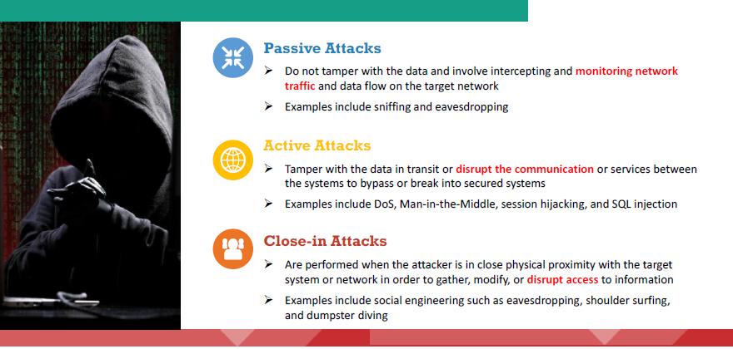
Classification of Attacks
According to IATF (Information Assurance Technical Framework), security attacks are classified into five categories: passive, active, close-in, insider, and distribution.
Dr. M Malook Rind Information Security Lecture 2

Slide 12
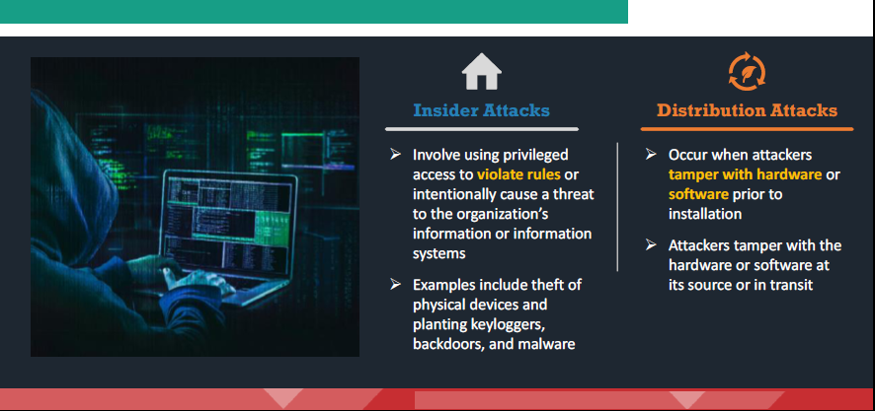
Classification of Attacks (cont…)
Dr. M Malook Rind Information Security Lecture 2

Slide 13
Classification of Attacks (cont…)
Passive Attacks
Examples of passive attacks:
Footprinting
Sniffing and eavesdropping
Network traffic analysis
Decryption of weakly encrypted traffic
Close-in Attacks
Examples of close-in attacks:
Social engineering (Eavesdropping, shoulder surfing, dumpster diving, and other methods).
Insider Attacks
Examples of Insider Attacks
Eavesdropping and wiretapping
Theft of physical devices
Social engineering
Data theft and spoliation
Planting keyloggers, backdoors, or malware
Dr. M Malook Rind Information Security Lecture 2

Slide 14
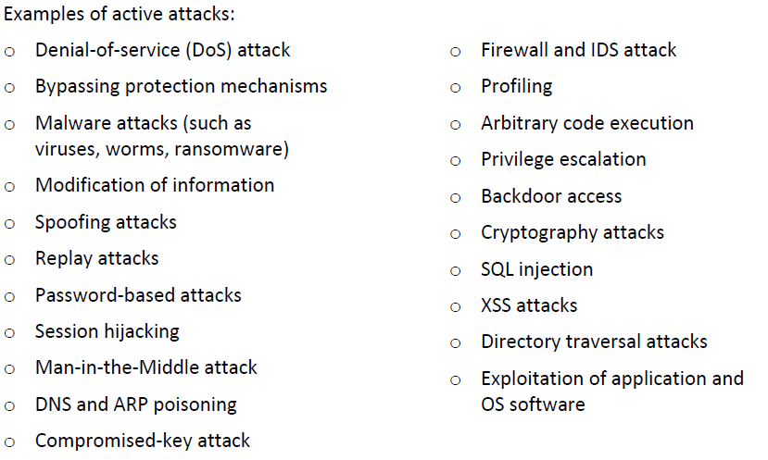
Classification of Attacks (cont…)
Active Attacks
Distribution Attacks
Examples of Distribution attacks:
Modification of software or hardware during production
Modification of software or hardware during distribution
Dr. M Malook Rind Information Security Lecture 2

Slide 15
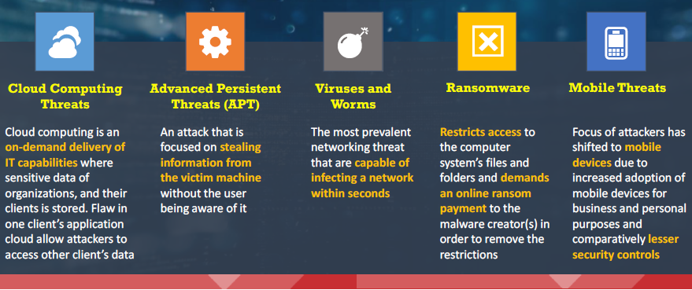
Information Security Attack Vectors
An attack vector is a pathway or method used by a hacker to illegally access a network or computer in an attempt to exploit system vulnerabilities. Hackers use numerous attack vectors to launch attacks that take advantage of system weaknesses, cause a data breach, or steal login credentials.
Dr. M Malook Rind Information Security Lecture 2

Slide 16
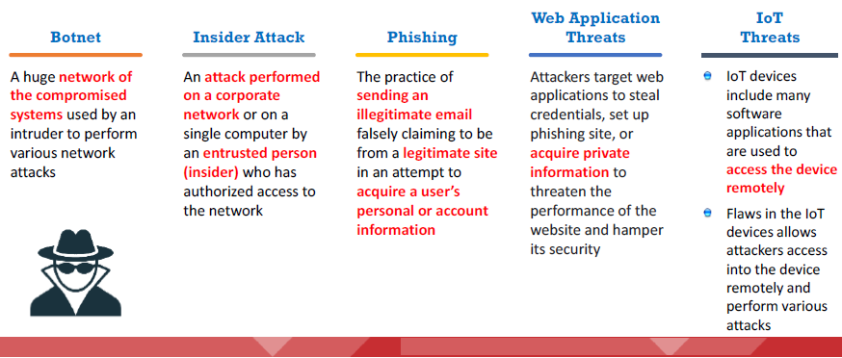
Information Security Attack Vectors (Cont…)
Dr. M Malook Rind Information Security Lecture 2

Slide 17
Hacking
Dr. M Malook Rind Information Security Lecture 2

Slide 18
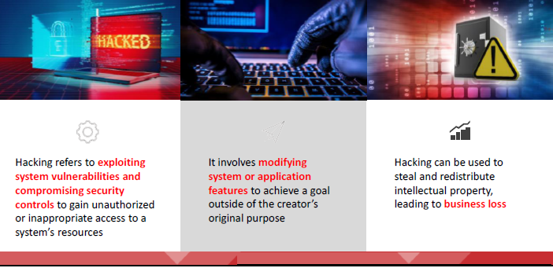
What is Hacking?
The motive behind hacking could be to steal critical information or services, for thrill, intellectual challenge, curiosity, experiment, knowledge, financial gain, prestige, power, peer recognition, and vengeance, among other reasons.
Dr. M Malook Rind Information Security Lecture 2

Slide 19
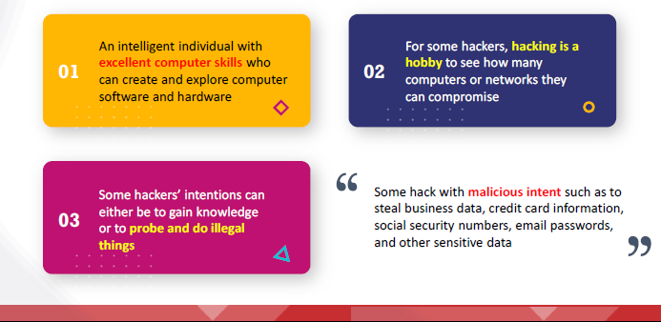
Who is a Hacker ?
A hacker is a person who breaks into a system or network without authorization and try to destroy, steal sensitive data, or perform malicious attacks. Usually, a hacker is a skilled engineer or programmer with enough knowledge to discover vulnerabilities in a target system.
Dr. M Malook Rind Information Security Lecture 2

Slide 20
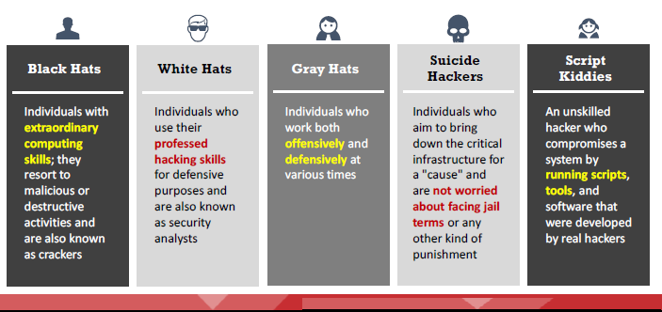
Who is a Hacker - Hacker Classes/Threat Actors?
Hackers/ Thread Actors can also be classified as:
Dr. M Malook Rind Information Security Lecture 2

Slide 21
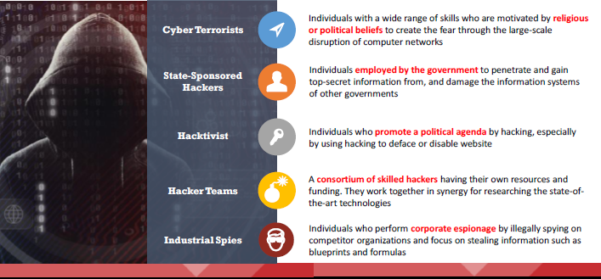
Who is a Hacker - Hacker Classes/Threat Actors? (Cont….)
Dr. M Malook Rind Information Security Lecture 2

Slide 22
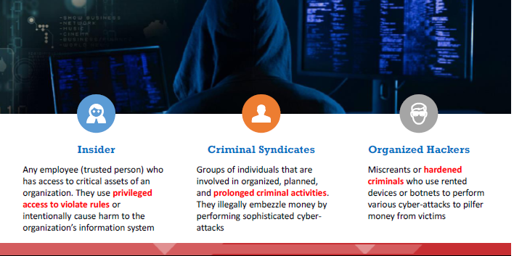
Who is a Hacker ?
Dr. M Malook Rind Information Security Lecture 2

Slide 23
Different Phases of Hacking Cycle
Organizations are recruiting cybersecurity professionals to curb the ever-evolving threats from security breaches. It is important for such security professionals to gain knowledge on various hacking phases, which will help them in analyzing and strengthening the security posture of the organization from various cyber threats.
Hacking Phases
In general, there are five phases of hacking:
Reconnaissance
Scanning
Gaining Access
Maintaining Access
Clearing Tracks
Dr. M Malook Rind Information Security Lecture 2

Slide 24
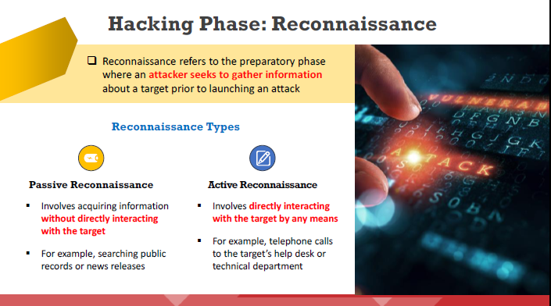
Different Phases of Hacking Cycle
The reconnaissance target range may include the target organization’s clients, employees, operations, network, and systems. This phase allows attackers to plan the attack. May involve social engineering, dumpster diving.
Dr. M Malook Rind Information Security Lecture 2

Slide 25
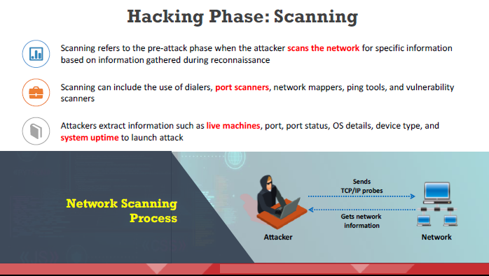
Different Phases of Hacking Cycle
Dr. M Malook Rind Information Security Lecture 2

Slide 26
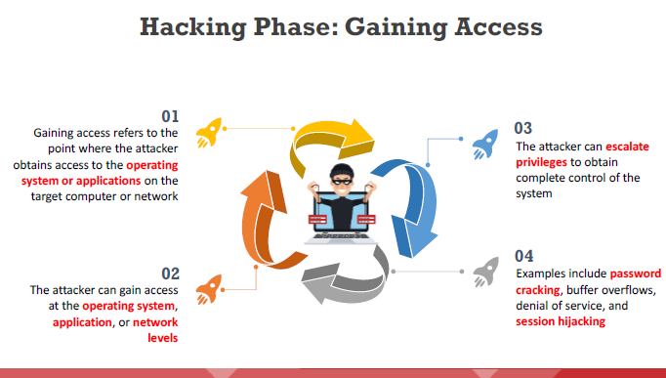
Different Phases of Hacking Cycle
Dr. M Malook Rind Information Security Lecture 2

Slide 27
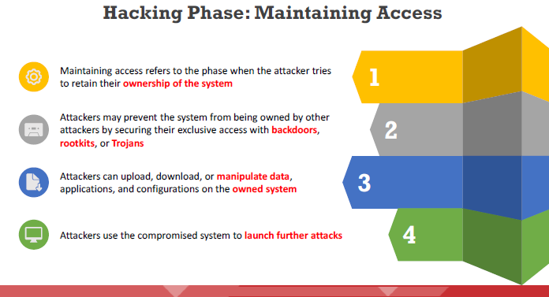
Different Phases of Hacking Cycle
Dr. M Malook Rind Information Security Lecture 2

Slide 28
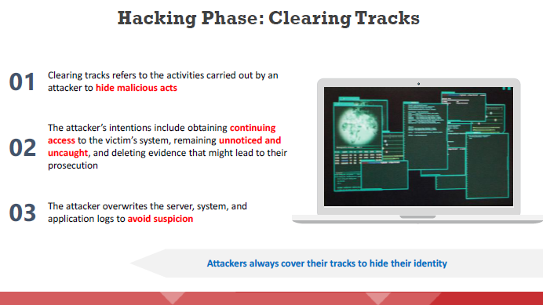
Different Phases of Hacking Cycle
Dr. M Malook Rind Information Security Lecture 2

Slide 29
What is Ethical Hacking
Ethical hacking is the practice of employing computer and network skills in order to assist organizations in testing their network security for possible loopholes and vulnerabilities.
White Hats (also known as security analysts or ethical hackers) are the individuals or experts who perform ethical hacking.
Dr. M Malook Rind Information Security Lecture 2

Slide 30
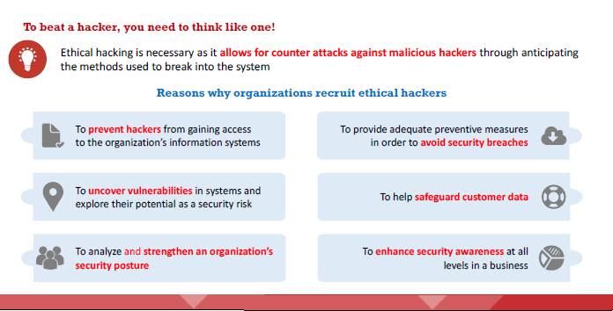
Why Ethical Hacking is Necessary
Dr. M Malook Rind Information Security Lecture 2

Slide 31
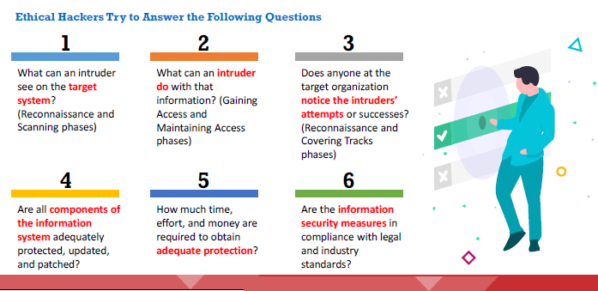
Why Ethical Hacking is Necessary
Dr. M Malook Rind Information Security Lecture 2

Slide 32
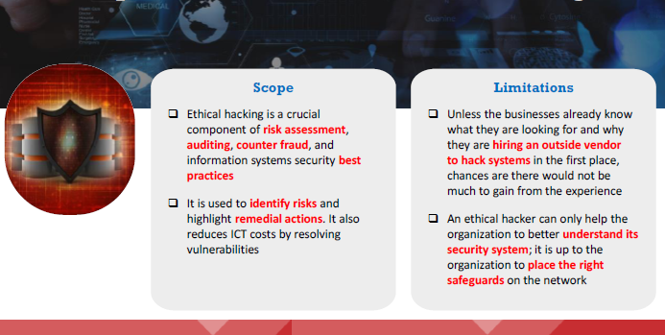
Scope and Limitations of Ethical Hacking
The entire process of ethical hacking and subsequent patching of discovered vulnerabilities depends on questions such as:
Dr. M Malook Rind Information Security Lecture 2

Slide 33
Scope and Limitations of Ethical Hacking
The ethical hacker must follow certain rules to fulfill their ethical and moral obligations. They must do the following:
Gain authorization from the client and have a signed contract giving the tester permission to perform the test.
Maintain confidentiality when performing the test and follow a Nondisclosure Agreement (NDA) with the client for the confidential information disclosed during the test. The information gathered might contain sensitive information, and the ethical hacker must not disclose any information about the test or the confidential company data to a third party.
Perform the test up to but not beyond the agreed-upon limits. For example, ethical hackers should perform DoS attacks only if they have previously agreed upon this with the client. Loss of revenue, goodwill, and worse consequences could befall an organization whose servers or applications are unavailable to customers because of the testing.
Dr. M Malook Rind Information Security Lecture 2

Slide 34
Cyber Kill Chain Methodology
Dr. M Malook Rind Information Security Lecture 2

Slide 35
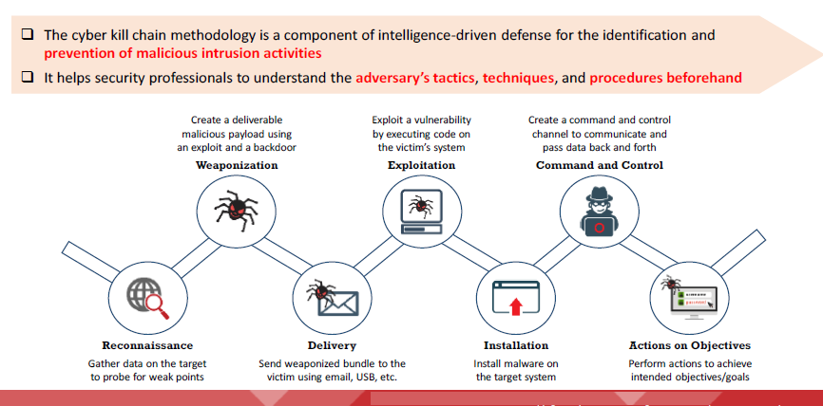
Cyber Kill Chain Methodology
The cyber kill chain is an efficient and effective way of illustrating how an adversary can attack the target organization. The cyber kill chain is a framework developed for securing cyberspace based on the concept of
military kill chains. This method aims to actively enhance intrusion detection and response.
Dr. M Malook Rind Information Security Lecture 2

Slide 36
Cyber Kill Chain Methodology
Reconnaissance: Activities of the adversary include the following
Gathering information about the target organization by searching the Internet or through social engineering
Performing analysis of various online activities and publicly available information
Gathering information from social networking sites and web services
Obtaining information about websites visited
Monitoring and analyzing the target organization’s website
Performing Whois, DNS, and network footprinting
Performing scanning to identify open ports and services.
Weaponization: The following are the activities of the adversary:
Identifying appropriate malware payload based on the analysis
Creating a new malware payload or selecting, reusing, modifying the available malware payloads based on the identified vulnerability
Creating a phishing email campaign
Leveraging exploit kits and botnets
Dr. M Malook Rind Information Security Lecture 2

Slide 37
Cyber Kill Chain Methodology
Delivery: Activities of the adversary include the following
Sending phishing emails to employees of the target organization
Distributing USB drives containing malicious payload to employees of the target organization
Performing attacks such as watering hole on the compromised website
Implementing various hacking tools against the operating systems, applications, and servers of the target organization
Exploitation: The following are the activities of the adversary:
Exploiting software or hardware vulnerabilities to gain remote access to the target System
Installation: The following are the activities of the adversary:
Downloading and installing malicious software such as backdoors
Gaining remote access to the target system
Leveraging various methods to keep backdoor hidden and running
Maintaining access to the target system
Dr. M Malook Rind Information Security Lecture 2

Slide 38
Cyber Kill Chain Methodology
Command and Control: Activities of the adversary include the following
Establishing a two-way communication channel between the victim’s system and the adversary-controlled server
Leveraging channels such as web traffic, email communication, and DNS messages
Applying privilege escalation techniques
Hiding any evidence of compromise using techniques such as encryption
Actions on Objectives: The adversary controls the victim’s system and finally accomplishes their intended goals. The adversary gains access to confidential data, disrupts the services or network, or destroys the operational capability of the target by gaining access to its network and compromising more systems. Also, the adversary may use this as a launching point to perform other attacks
Dr. M Malook Rind Information Security Lecture 2

Slide 39
Thanks
Dr. M Malook Rind Information Security Lecture 2

